Slide 1
MDC Webinar Series: The Community Visioning Process in Bucksport and Gorham
We will be starting the webinar promptly at 8:00am

Slide 3
Notes for Today
Today’s webinar is being recorded and will be made available after the program
If you have questions please use the chat feature on your screen
The webinar will be 40-45 minutes.

Slide 4
Joining Us Today
Host:
Anne Ball, Maine Downtown Center, Maine Development Foundation, aball@mdf.org
Guests:
Kathy Garrard, President, Affiliate Program, Gorham Village Alliance, kathy.garrard@powereng.com
Brook Minner, Director, Affiliate Program, Bucksport Main Street, brook@mainstreetbucksport.org

Slide 5
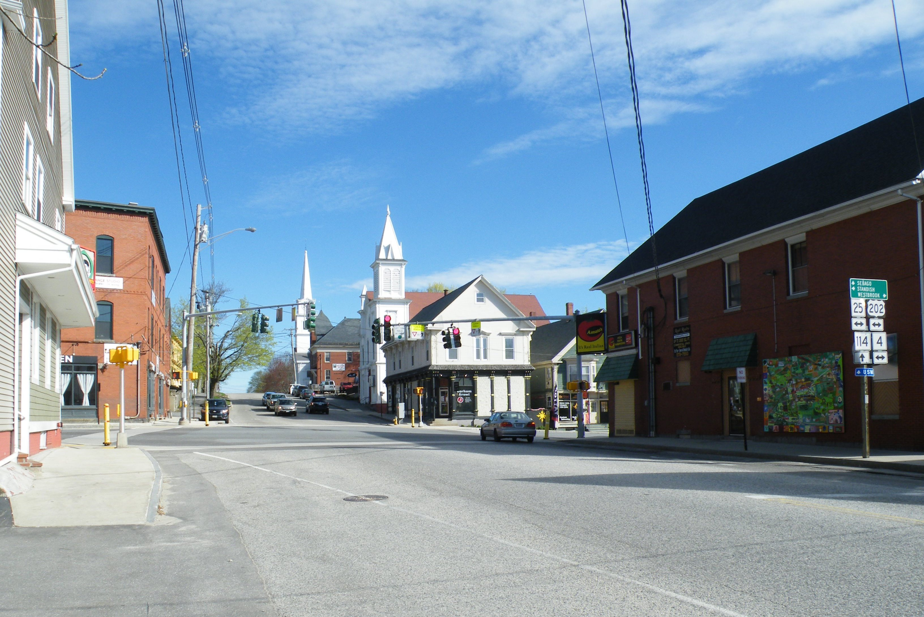
Gorham
Downtown Gorham

Slide 7
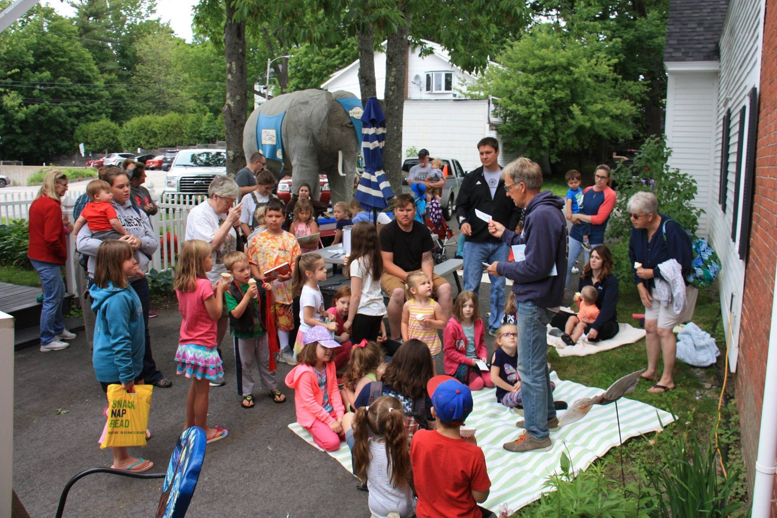
Downtown Bucksport: Kids on Main Event

Slide 8
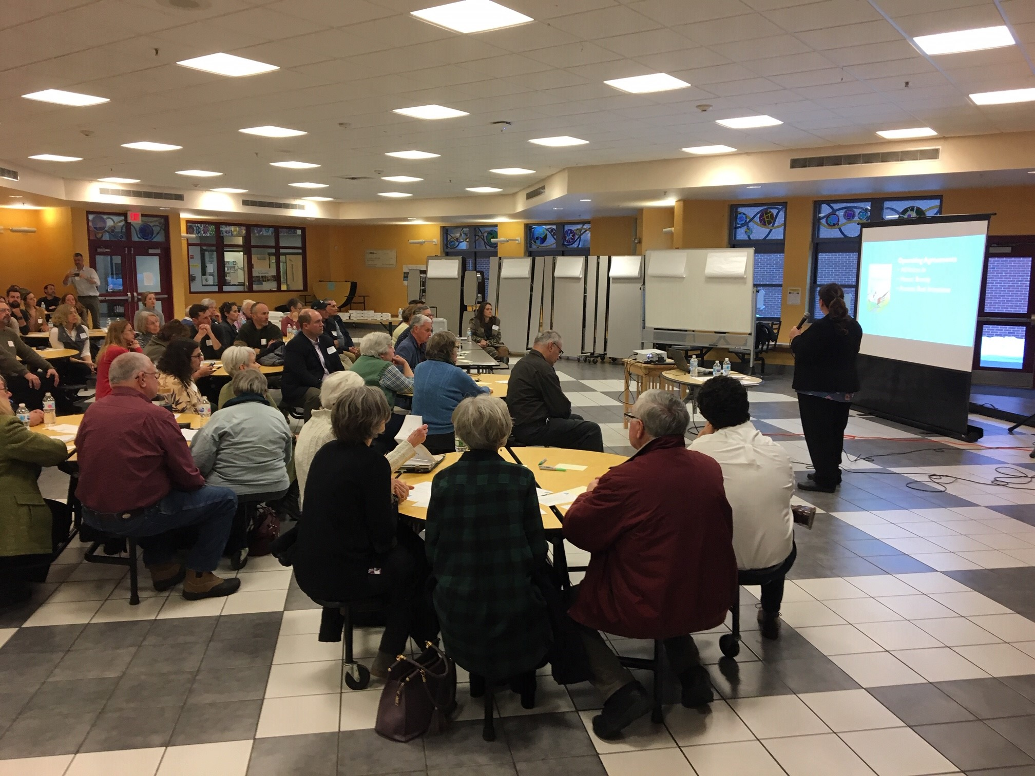
Gorham Visioning Session

Slide 9
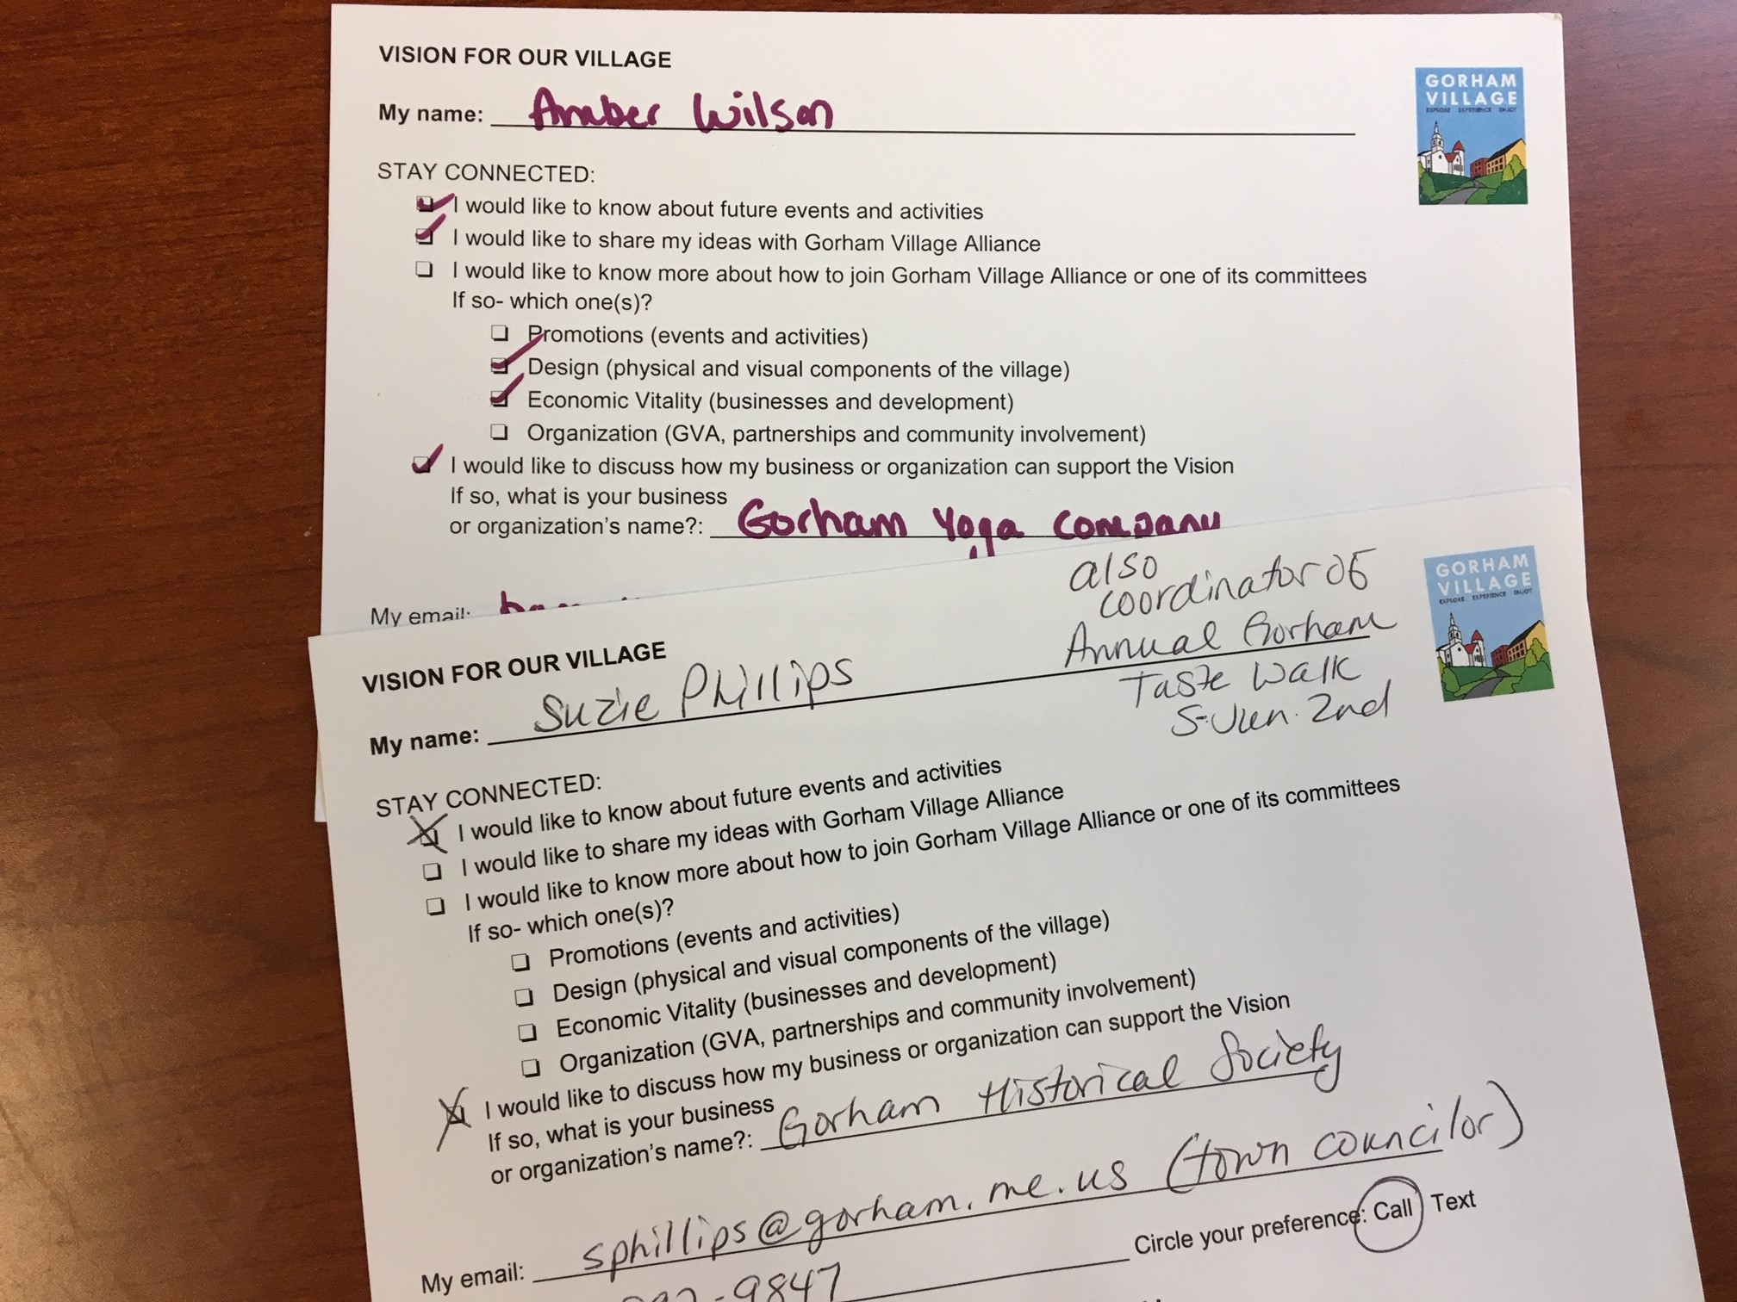

Slide 14
The Main Street Approach

Slide 15
Thank you to our guests today
Kathy Garrard, President, Affiliate Program, Gorham Village Alliance, kathy.garrard@powereng.com
Brook Minner, Director, Affiliate Program, Main Street Bucksport, brook@mainstreetbucksport.org

