Slide 1


Bookend Title:
Event
Date
Location
WEBINAR
Fundraising Events:
Easy Tips and New Ideas
January 28, 2020
Anne Ball
Program Director

Slide 2

“Transition slide text or quote”
Anne Ball
Program Director

Slide 3
“Transition slide text or quote”
Anne Ball
Program Director

Slide 4
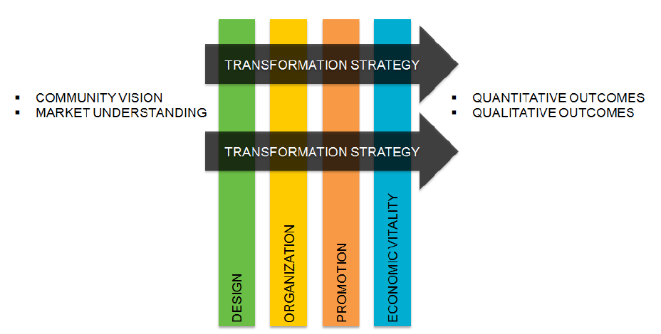
The Main Street Approach
“Transition slide text or quote”
Today’s Topic: Fundraising Events
Anne Ball
Program Director

Slide 5
Reminders for Today
If you have questions please use the chat feature on your screen
The webinar will be 40-45 minutes
Following the webinar we will send you a short survey, a link to the webinar recording and any handouts referenced.
“Transition slide text or quote”
Anne Ball
Program Director

Slide 6
Income Sources
Municipal Contributions
Annual Pledge Drive
Merchandise
Sales
Grants
Fundraising Events
“Transition slide text or quote”
Anne Ball
Program Director

Slide 7
Who Develops a Comprehensive Fundraising Strategy?
Who Implements the Fundraising Strategy?
Board, committees, project task force, and staff all share in implementation
Should be developed and led by the Board
“Transition slide text or quote”
Everyone must play an active role.
Anne Ball
Program Director

Slide 8
Fundraising Events Best Practices
1. Coordinate entire year’s calendar
2. Strive to have events break even or make $
3. Committees should ID businesses to solicit
“Transition slide text or quote”
Anne Ball
Program Director
Notes:
Who will be contacted and what amount will they be asked to pay for sponsorship? Keep in mind that money raised during the annual pledge drive comes from the “charitable” side and money to sponsor events comes from a “marketing” pot of money
3. Have each committee, with special projects or special events, note the businesses they would like to solicit as sponsors. Make sure there is a plan so that businesses know what kind of recognition they will receive.

Slide 9
4. Build admin fee into sponsorships
5. Review each event
6. Have events paid for by sponsors
“Transition slide text or quote”
Anne Ball
Program Director
Notes:
4. Many businesses have indicated they no longer want to support the administrative operation of Main Street programs, but will sponsor projects that their name will be on. For example, if a business if asked to sponsor Main Street’s newsletter, their fee should not just cover the amount of postage and printing. Add a fee that will include staff time to complete this project. Building in an administrative fee to each and every project will help close the gap on the administrative budget.
5. Review each event or projects as soon as it is complete and access new ways to increase sponsorships and fundraising for the following year
6.Try to have all special events paid for by sponsors before the event even happens. This assures that money will not be lost if the event is rained out

Slide 10
7. Offer Perks for sponsors
“Transition slide text or quote”
Anne Ball
Program Director
Notes:
Offer special perks for sponsors, VIP parking, bathroom facilities, T-shirts for their employees, masters of ceremony or award presentations and photo-ops.

Slide 11
Success Means?
Amount of $ raised vs. staff/volunteer time
Generates good stories, PR
Increases # of volunteers, friends, partners
Raises awareness of who you are
What else?
“Transition slide text or quote”
Anne Ball
Program Director

Slide 12

Maine Examples of Successful Fundraising Events
LOVE YOUR DOWNTOWN RAFFLE
- Board sells raffle tickets ($25 each) for 5 prize packages (worth $200 each)
- 5 prize packages in pretty baskets are made up of downtown business donations (approximately $20 each)
Opportunity to promote participating downtown business
Limited # of tickets are sold
Board can really do this, not something that slips back into the hands of the staff, as happens with events.
If you buy 4 tickets you get 5th free for cash drawing.
Fun to reveal at an event (whether formal or informal)
-Net $6500
“Transition slide text or quote”
Anne Ball
Program Director

Slide 13
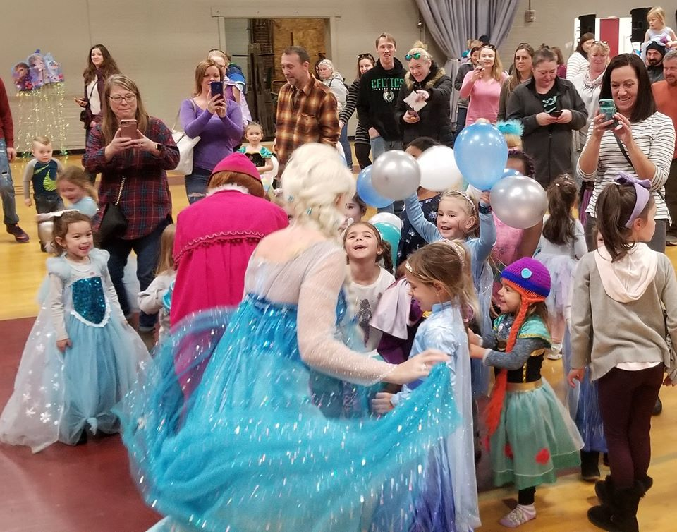
Frozen Princess Party, Saco Main Street
- 2 hr Event w/Frozen Princesses and Olof the Snowman
- Hot chocolate and ice cream sold by Saco Scoop.
- Held at Saco Parks and Rec Gym at no cost
- Well attended and received by parents, planned in 14 days.
Activities: crafts, games, dance party and meet & greet w/Princesses and Olof
NET $1500
“Transition slide text or quote”
Anne Ball
Program Director

Slide 14
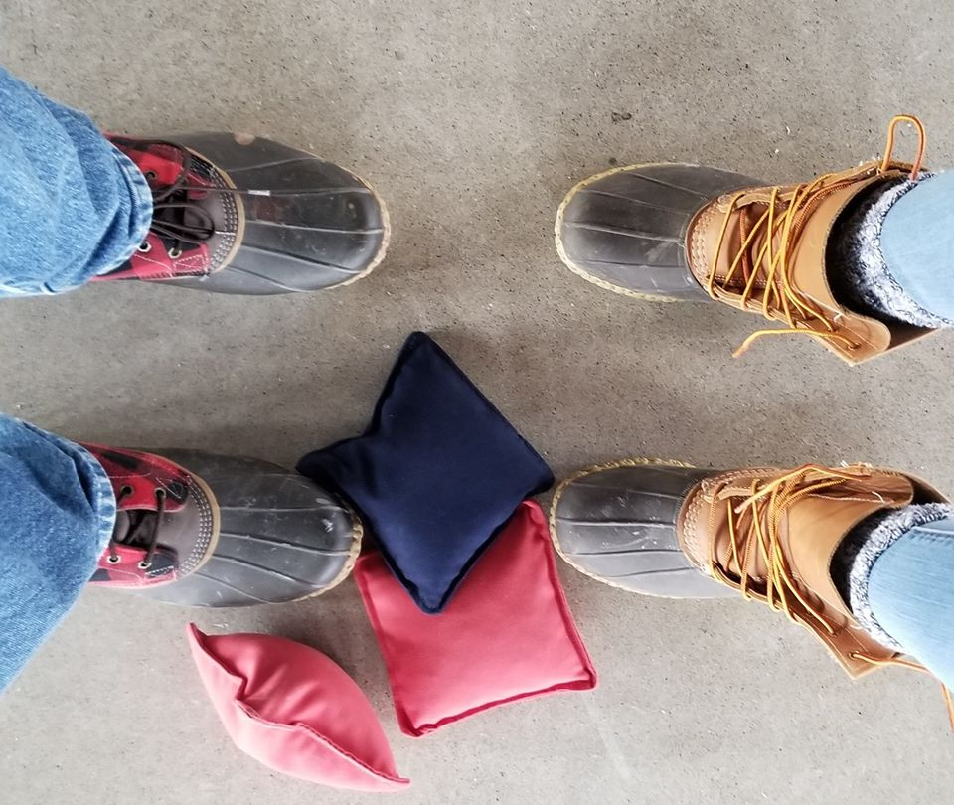
Cabin Fevah Relivah
Saco Main Street
-March event in vacant mill space.
-Activities: corn-hole tournament, large Jenga, and Connect 4, photo booth, Best Dressed Mainah Contest .
-$25 tix (w/ 3 food servings & 2 beers).
-5 breweries and 5 restaurants donated their products.
-Attracted demographic (25 – 40 yrs), came from places like Kittery, Sebago, Lewiston/Auburn, and Dover, NH.
Net $5,000.
“Transition slide text or quote”
Anne Ball
Program Director

Slide 15
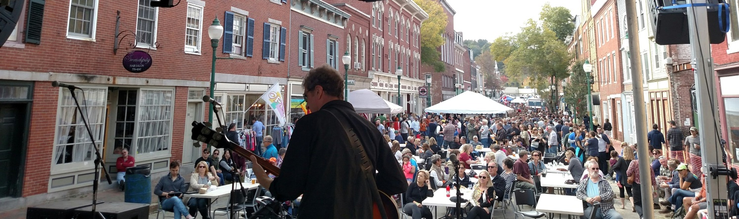
Swine and Stein, Gardiner Main Street
-Celebrated all day in historic Gardiner in October. Began in 2008.
-Beer festival, live music, quirky games, variety of food vendors and all-day tastings from some of Maine's best breweries, wineries and distilleries.
-The event was reformatted from a traditional Oktoberfest to a brewfest in 2019, after seeing declining attendance and profits. The new 2109 Brewfest netted over $23,000, up almost $10,000 from the year before.
-Best fundraising event, for Gardiner Main Street, it is by no means easy.
Net $23,000
“Transition slide text or quote”
Anne Ball
Program Director

Slide 16

Lobster Trap Raffle, Rockland Main Street
-Traps that are used in the lobster trap Christmas Tree are raffled.
-You can win either 50 traps or an alternative cash prize of $2,250.
-250 tickets sold at $50 apiece
-Tickets sold at 6 - 8 separate retail outlets and banks.
-This takes only staff time and is mostly an administrative process without a lot of effort.
NET $7000-$8000
“Transition slide text or quote”
Anne Ball
Program Director

Slide 17

Community BBQ, Brunswick Downtown Association
-held on the Town Mall 3rd Saturday in June, pays tribute to local First Responders
-Serves as the kick-off event for downtown summer programs .
-Family oriented, music, activities, food, tours of fire trucks and EMT vehicles.
-Low cost for attendees ($5 for adults, $3 for kids for the food).
-Easy to attract sponsorship and volunteers.
Net $12,500 in 2019 - up from $3,500 in 2018.
“Transition slide text or quote”
Anne Ball
Program Director

Slide 18

River of Trees, Augusta Downtown Alliance
Christmas Tree raffle, $2 admission and .50 raffle tix
Local businesses donate trees and decorate them
People bid on trees worth $500-$1000 each
NET $16,000-$18,000
“Transition slide text or quote”
Anne Ball
Program Director

Slide 19

Tribute to Elton John Concert, Main Street Bath
-Outside, family friendly event
-Nostalgic- everyone loves Elton
-Tickets $30 each
-Easy fundraiser
-Bath’s Elton is a nationally recognized tribute artist
Net $20,000
“Transition slide text or quote”
Anne Ball
Program Director

Slide 20
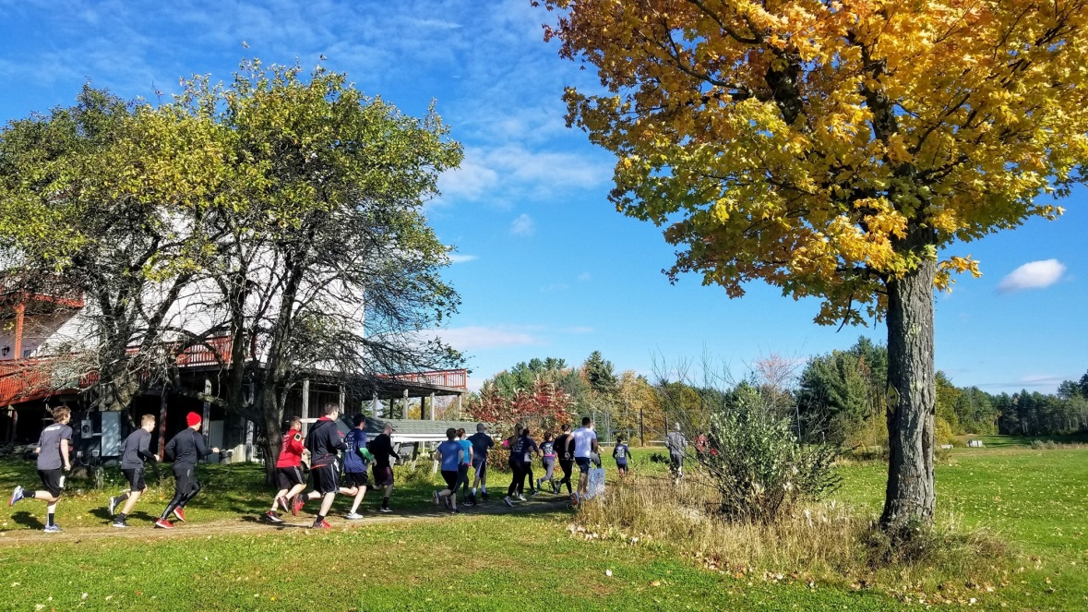
Run the Ridge Trail Race,
Discover Downtown Westbrook
- Road race: 10K, 5K, and K9 5K (run with your dog) on the trails at Sunset Ridge Golf Course.
- In 3 years, registration has grown from 60 to over 170
Participants learn about the trails, a hidden Westbrook gem
Do post event surveys to improve every year.
Building connection to other city owned lands
Net: over $7000
.
“Transition slide text or quote”
Anne Ball
Program Director

Slide 21
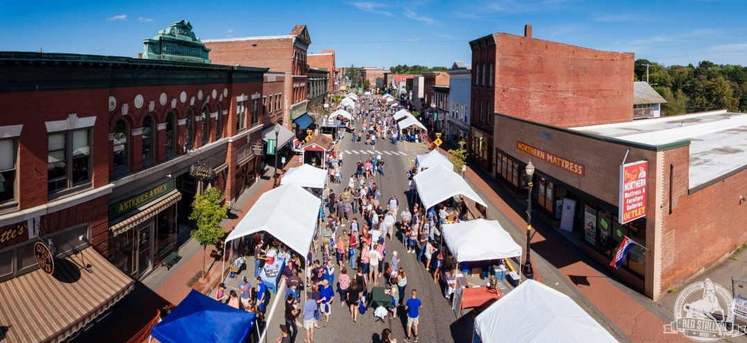
Skowhegan Craft Brew Fest, Main Street Skowhegan
-This is MSS’s best fundraising event.
-Elevated community pride
-Put Skowhegan on the map as a craft beer destination in Maine.
-20% of advanced ticket sales were to out-of-state residents in 2019
NET $30, 000 (predicted for 2020)
“Transition slide text or quote”
Anne Ball
Program Director

Slide 22
Takeaways
Big or Small event with varied levels of effort
Range of type of events: music, brew, running race, dogs, raffles
Events are one part of an overall fundraising plan
Get sponsors to cover the costs
Follow up with survey and improve
It typically takes 3 years to build an event
It is ok to stop doing an event if it is not worth it anymore.
Think of underutilized spaces
Anne Ball
Program Director

Slide 23
“Wquestions and answers
Anne Ball
Program Director

Slide 24
Thank you for attending the MDC Webinar:
Fundraising Events: Tips and New Ideas te
Anne Ball, aball@mdf.orgxt or quote”
“Transition slide text or quote”

