Slide 1
Project Strategy & Design
Professional Grant Development Workshop
1901 N. Fort Myer Dr., Suite 1016
Arlington, Virginia
granttrainingcenter.com

Slide 2
Grant Training Center
Services:
Federal grant and foundation searches
Member Community
Live and online training
Proposal reviews & editing
One-on-one assistance

Slide 3
Workshop Goals
Increase knowledge of the grant writing process
Experience in reviewing funding information to determine alignment with your institution’s needs/goals
Develop a project outline/concept paper addressing a grant RFP/RFA
Make an individual commitment to be involved in preparing a full grant proposal

Slide 4
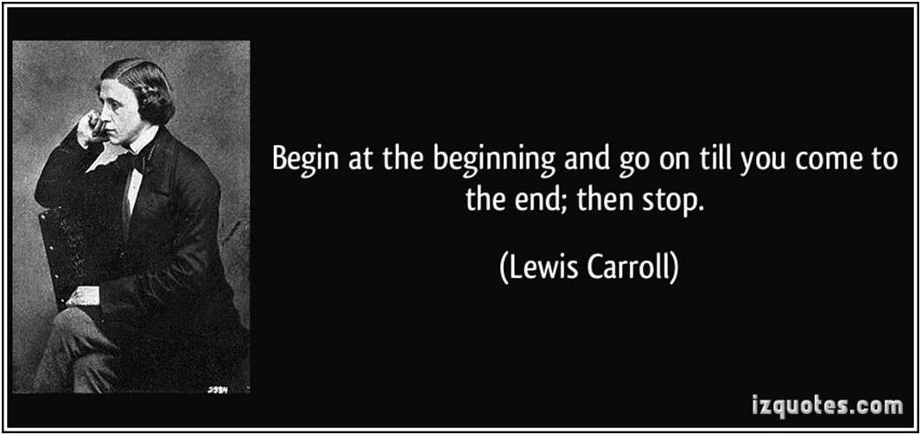
Grant Writing Made Easy

Slide 5
The Truth about Writing Grants
Developing a successful grant “system” takes work
Funders don’t care what you need or want to do
Better to write one grant and be awarded than use a “shotgun” approach
Ask for the specific amount of money you need
Good applications can be helped to the top

Slide 6
The Truth about Writing Grants
Best way to never get a grant
Don’t write one!
Best way to get a grant
Follow the instructions!

Slide 7
Steps to Successful Grantsmanship
Know who you are & what you want to accomplish
Know what needs to be done & how you want to achieve it
Build a relationship with the funding source
Write a winning proposal
Follow through!

Slide 8
Background and Introduction
Start with a good idea!
Poor ideas will not be successful
Regardless of how well they are “packaged”
Good ideas are often not funded
Not packaged well
For every good idea that is funded, there are others that aren’t
Not packaged well
Then improve the packaging!

Slide 9
Background and Introduction
Acronyms used in this presentation
RFA = Request for Applications
RFP = Request for Proposals (same as RFA)

Slide 10
Ten Things You Must Do
1a. Find the right program for you and your idea
Main purpose of program (funding priorities)
Does your idea fit in mainstream or on the fringe?
Find abstracts of previously funded projects
Great source of information
Call the Program Manager
To discuss your idea relative to the program priorities

Slide 11
Ten Things You Must Do (cont.)
1b. Find the right program for you and your idea
Best approach
Find a program in your area, determine its priorities, then develop an idea
Don’t waste time applying to the wrong program
Square pegs do not fit in round holes
Eligibility restrictions?

Slide 12
Ten Things You Must Do (cont.)
2. Become a “Student” of the RFA/RFP
Understand the main goals of the program
Does your idea fit within these goals?
Don’t hesitate to call the Program Manager
Understand the directions outlined in the RFA/RFP

Slide 13
Ten Things You Must Do (cont.)
3. Develop a timeline for proposal preparation
The timeline should allow for completion of proposal
2 weeks before submission deadline
If you rush preparation of the proposal, it will show
Reviewers will notice and will not be kind

Slide 14
Ten Things You Must Do (cont.)
4a. Understand criteria used to evaluate proposals
RFA/RFP normally contains the criteria used by reviewers to evaluate your proposal
Understand criteria BEFORE you begin preparing your proposal
Provides a greater understanding as to where to put the greatest efforts

Slide 15
Ten Things You Must Do (cont.)
4b. Understand criteria used to evaluate proposals
Review criteria typically includes:
Scientific merit or Need-based
Relevance to program priorities
Qualifications of project personnel
Planning and administration of project

Slide 16
Ten Things You Must Do (cont.)
5a. Understand the review process and reviewers
Reviewers are provided evaluation guidance
Use the criteria in the RFA
Reviewers evaluate each proposal
Strengths, weaknesses, qualifications of personnel, probability of success, etc.
Individual reviewers vs. group (review panel) scores
Reviewers are looking for proposals they can champion & for those they can dismiss

Slide 17
Ten Things You Must Do (cont.)
5b. Understand the review process and reviewers
Each reviewer may be assigned 10 to 25 proposals
Following directions in the RFA/RFP helps reviewers
Prepare the proposal logically and clearly
Making a reviewer work harder decreases the probability of you getting funded!
Work to make reviewers champion your proposal

Slide 18
Ten Things You Must Do (cont.)
6a. Write the proposal logically and clearly
Project Summary or Abstract
The most important section of the entire proposal
Summary captures the essence of your proposal
Must be clear, concise, well articulated and logical
Typically every reviewer only reads this section
Organize according to what is the most logical
The outline in RFA/RFP or the evaluation criteria

Slide 19
Ten Things You Must Do (cont.)
6b. Write the proposal logically and clearly
Following the prescribed format makes reviewers happy and more generous
Making reviewers work hard hurts you
Background establishes the need for the project
Must be important and interesting
The need can be readily identified with the priorities
Make sure you say it in the proposal!

Slide 20
Ten Things You Must Do (cont.)
6c. Write the proposal logically and clearly
Overarching hypothesis
Or goal
Specific aims that test the hypothesis or measurable objectives
Methodologies/activities with associated timelines
Expected outcomes and impacts

Slide 21
Ten Things You Must Do (cont.)
6d. Write the proposal logically and clearly
Reviewers must be convinced:
Goal(s) reflect major priorities of the program
If objectives are accomplished, you will attain goals
If methodology is followed, objectives will be attained
Expected results are directly related to overall goals and priorities of the program

Slide 22
Ten Things You Must Do (cont.)
6e. Write the proposal logically and clearly
Reviewers must be convinced:
Proposed evaluation plan will keep you on track to successful completion of the project
Probability of success is acceptable
Proposal NEEDS to be FUNDED

Slide 23
Ten Things You Must Do (cont.)
7. Prepare budget with a strong justification
Use timeline
Compute the amount of time personnel will spend carrying out each portion of the project
Unreasonable budgets hurt proposals
They create skeptics within reviewer ranks
Keep budgets within guidelines in the RFA/RFP
They are judged on the degree of reasonableness

Slide 24
Ten Things You Must Do (cont.)
8a. Obtain critical input from experienced and successful colleagues
One who has significant expertise in the topic area
Another who has only passing familiarity (or less) with the subject matter
A third who is an excellent writer

Slide 25
Ten Things You Must Do (cont.)
8b. Obtain critical input from experienced and successful colleagues
Someone who…
Talks frankly, bluntly and clearly
Does not beat around the bush
Has little sympathy for your ego
Is smart and crafty
Has success in obtaining grants

Slide 26
Ten Things You Must Do (cont.)
9. Fill out forms completely and correctly
10. Allow time for intramural administrative requirements
Submit in a timely manner!
A Deadline is A Deadline!!!

Slide 27
Funding Resources
Public Sources of Funding
Federal agencies (non-competitive)
Formula Grants, Entitlements/Block Grants generally awarded through states, counties or cities
Competitive
Federal agency awards to a specific grantee in response to a request for proposals or notice of funds available
State and local agencies

Slide 28
Types of Funding
Private Sources of Funding
Foundations
General support, endowments, project grants, Challenge (Matching) grants, Fellowship, & Capitol grants
Corporations
Direct cash, donations
Equipment, facilities, land, employee services, etc.
Marketing & promotion products
Creating income

Slide 29
Types of Funding (cont.)
Professional & Trade Associations
Groups such as fraternities, sororities, labor unions, etc.
Generally smaller $ for a specific purpose
Fundraising Activities
Activities an organization sponsors to fund specific projects

Slide 30
Advantages of Funding Sources
Public
Private
Purpose set by legislation
Most likely to award large contracts
Most likely to pay all project costs
Uses prescribed formats for proposals
Most likely to offer technical assistance
Funds available to a wider array of organizations
Focus on “emerging issues”
Wide range in size of available grants
Willing to support start-up funds
Complex proposals are not always required
May provide alternative forms of assistance

Slide 31
Disadvantages of Funding Sources
Public
Private
More bureaucratic
Complex proposal requirements & compliance procedures
Sometimes difficult to sell new ideas/high risk approaches
Changing political trends…
Grants are usually smaller
Information on policy & procedures and must be researched
Limited staff, less opportunity for personal contact
Less likely to cover all project

Slide 32
Decision Points for
Government Grants
Who is eligible?
What is the deadline(s)?
What is the CFDA number?
What is the award amount per grant?

Slide 33
Decision Points for Government Grants (cont.)
How many projects will be funded?
Is there a match requirement?
Where do I get the full application?
What are the format requirements?

Slide 34
Decision Points for Foundation Grants
Research foundations
Select 5 to 10 related to project need
Check annual reports
Look for matches
Develop/draft proposal
Make contacts and ask questions
Revise proposal
Meet deadlines

Slide 35
Decision Points for Government Grants
What forms are required & what/whose signatures are needed?
Who is the program contact?
Where do I submit the application and in what form?

Slide 36
Decision Points for Corporate Grants
Develop prospects through research
Find & use a champion
Determine match/prepare proposal
Make contacts
Follow proposal requirements
Application, presentation, etc.

Slide 37
Be Prepared
What is the problem?
What data demonstrates that need?
What project idea do you propose?
What are the goals and objectives?
How long will it take to implement your project?
How will you know your project was successful?
What resources (time, money, staff) do you need?

Slide 38
Be Prepared (cont.)
Ask others for advice
Identify a funder and check your eligibility
Obtain guidelines on procedures
Ask questions of the funder
WRITE
Follow the instructions!

Slide 39
Factors Considered in a Grant Award
Capacity of the application & organization
Extent of the Need/Problem
Balanced Approach/clear proposal
Utilizing available resources
Project evaluation/results

Slide 40
Proposal Details
“In language, clarity is everything…”
- Confucius

Slide 41
Timelines for Scientific Grants
1.5 – 1 year before deadline
Discuss ideas with others
Complete current experiments & publish results to show:
Productivity
Ability to take a project from an idea to published completion

Slide 42
Timelines for Scientific Grants (cont.)
12 - 6 months before deadline
Generate preliminary data
6 - 3 months before deadline
Create initial draft of proposal
3 - 2 months before deadline
Obtain comments from colleagues, revise accordingly

Slide 43
Timelines for Scientific Grants (cont.)
2 - 1 months before deadline
Prepare budget and “non-science” parts
1 month before deadline
Have draft of “final version”
Obtain additional comments from colleagues on the “whole package”

Slide 44
Timelines for Scientific Grants (cont.)
2 - 1 weeks before deadline
Final version is proofread by someone new
Then proofread again!
7 - 5 days before deadline
Make necessary copies of all parts
Figures, etc.
Obtain required signatures
3 - 2 days before deadline
Submit proposal

Slide 45
Helpful Hints for
Hypothesis-Driven Grants
Develop an overarching hypothesis
A testable idea or notion
Basic premise for the proposal
Once formed and focused, it should drive the rest of the proposal
Bigger than the specific aims or objectives

Slide 46
Helpful Hints for
Hypothesis-Driven Grants (cont.)
Hypothesis
Not in the form of a question
Repeat in the Abstract, Background, Specific Aims
State exactly the same way throughout
Same applies for Specific Aims

Slide 47
Helpful Hints for
Hypothesis-Driven Grants (cont.)
Specific aims
Compelling
Clearly hypothesis-driven
Not names of experiments

Slide 48
Helpful Hints for
Hypothesis-Driven Grants (cont.)
Avoid using terms indicating ‘description’
“Correlate”
“Describe”
“Assess”
“Measure”
Avoid passive voice, flowery terms, wishy-washy terms

Slide 49
Helpful Hints for
Hypothesis-Driven Grants (cont.)
Each section of the proposal is linked to each other
Rationale for each study is linked to an aspect of hypothesis
Potential outcomes of experiments are linked to proving or disproving the hypothesis

Slide 50
Helpful Hints for
Hypothesis-Driven Grants (cont.)
High probability of success
Focused
Not a fishing expedition
Feasible
Solid preliminary data
Letters from experts expressing support & willingness to help

Slide 51
Helpful Hints for
Hypothesis-Driven Grants (cont.)
Significance
Not a mystery novel
Deliver message fast
Proposed studies yield information that is unique
Other approaches do not work as well
Relevant to the ‘big picture’
Key to convincing reviewers to support your proposal rather than that of your competition

Slide 52
Common Criticism for
Hypothesis-Driven Grants
Poorly written
Not well justified
Scientific problem
Experimental model
Relevance to program priorities or purpose
Lacks convincing preliminary data

Slide 53
Common Criticism for
Hypothesis-Driven Grants (cont.)
No hypothesis or poorly presented
Not hypothesis-driven, studies are descriptive
Objectives
Don’t address hypothesis
Lack focus, too diffuse

Slide 54
Common Criticism for
Hypothesis-Driven Grants (cont.)
Approaches & methods lack detail needed to evaluate potential for success
Investigator lacks expertise with given approach
Expected results not presented, interpreted
Pitfalls not addressed, alternative solutions not presented

Slide 55
Common Criticism for
Hypothesis-Driven Grants (cont.)
Overly ambitious, too much or too difficult to accomplish in reasonable timeframe
Timeline unrealistic for successful completion of proposed project
Resubmitted proposal did not address concerns identified during previous review

Slide 56
Proposal Summary/Abstract
A clear concise summary should contain
Identification of applicant and credibility
Issue/problem to be met

Slide 57
Abstract/Summary
Objectives to be achieved
Activities to be conducted to achieve objectives
Total cost of the project & amount requested

Slide 58
Examples of Abstract
Summary Page
Specific Aims Page
Abstracts

Slide 59
Needs Statement for Project Grants
Interesting to read and accurate
Related to purposes and goals of your organization
Supported by evidence
Data
Is responsible
Issue/situation you can really do something about over the course of the grant
Stated in terms of the clients or beneficiaries

Slide 60
Need Statement Blog
Writing a Compelling Need Statement

Slide 61
Objectives for Project Grants
Describes problem
Related outcomes (not methods) of your program
To increase, reduce, etc.
Measurable & demonstrates effectiveness
“Who is doing what, when, how much, and it will be measured by…”

Slide 62
Objectives for Project Grants (cont.)
Defines the population served
Includes the time involved
Described in numerical terms
If possible

Slide 63
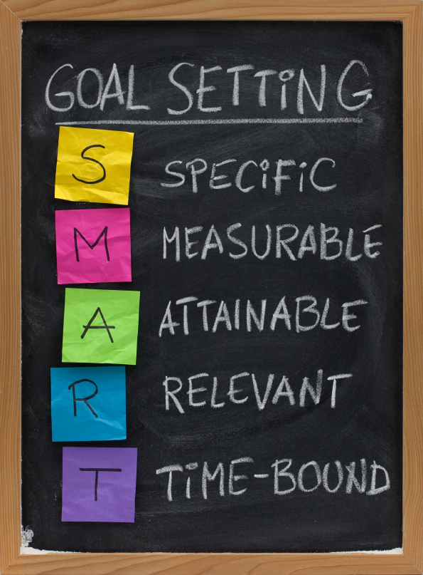
Objectives for Project Grants (cont.)
Specific
Measurable
Attainable
Relevant
Time-bound
Picture from: voice123.com

Slide 64
Methods for Project Grants
Flows naturally from problem & objectives
Clearly describes program activities
States reason for activities
Describes staff & client selection
Shows that time and resources requested will achieve objectives
Problem
Objective #1
Objective #2
A
B
C
D

Slide 65
Objectives Blog
Developing SMART Objectives

Slide 66
Evaluation
Clarifies program objectives…
Process evaluation
Program has been conducted in a way consistent with plan/proposal
Product evaluation
Measures outcomes, impact, or summative evaluation

Slide 67
Evaluation (cont.)
Defines evaluation criteria
Identifies data gathering methods
Explains any tests or surveys
Describes process of data analysis & how results will be used

Slide 68
Evaluation Blog
Evaluation: Measuring Success

Slide 69
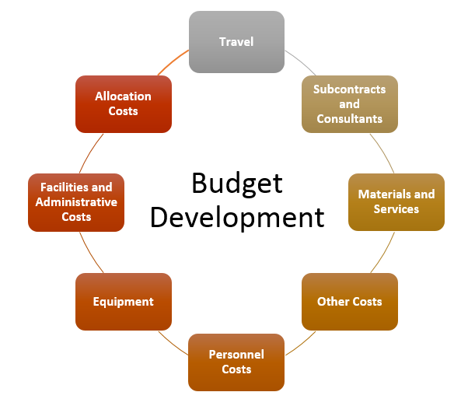
Budget
Should include all costs for all years of the grant
Read & understand the budget form(s)
Image from https://osp.mit.edu/grant-and-contract-administration/preparing -and-submitting-proposal/budget-development

Slide 70
Budget (cont.)
Should demonstrate that grant funds are aligned with funding agency policies
Describe how costs are derived
Discuss necessity and reasonableness
Describe specific functions of personnel, consultants, purchases, etc.

Slide 71
Budget (cont.)
Match activities, resources, & staff to cost/ budgetary items
Budget narrative and project narrative must match
Referencing same activities, resources needed, etc.
Triple-check mathematics!

Slide 72
Budget Blog
Justifying your Proposal: The Budget

Slide 73
Concept Paper
Describes your project in 2 to 4 pages
Identifies the need the project addresses
Discusses what has been done to address the problem
Explains your solution
Reports your baseline data
Identifies resources you have/need
Develops a timeline for activities
Defines anticipated outcomes

Slide 74
Concept Paper Components
Cover Letter (one page)
Abstract
Introduction
Needs/Significance Statement
Program Description
Evaluation

Slide 75
Concept Paper
Program Description
What you are doing and for whom?
Plan to address the need/problem
Install confidence to alleviate questions
What, how, for whom, how many?
Staffing
Sites and timeline

Slide 76
Useful Tips
Make the proposal structurally clear
Make proposals easy to skim and FIND answers
Use active verbs and simple constructions
Convey enthusiasm

Slide 77
Visual Aides
Charts, tables, maps, and graphs:
Maximize space
Emphasize main points
Allow for quick comparisons
Make sure symbols are clear when copied!

Slide 78
Commonly Cited Proposal Weaknesses
Problem is not one of interest to funder
Reader cannot locate scoring information
Missing or incomplete answers
Problem Statement is not well defined, documented, or understandable
Objectives
Too vague or not measurable
Do not match problem statement(s)

Slide 79
Commonly Cited Proposal Weaknesses (cont.)
Budget not substantiated by the narrative and/or costs for budget items are inaccurate or inflated
Use of jargon, abbreviations, and/or buzzwords
Readers may not know
Staff responsibilities are not explained
Time commitment
Evaluation
Only summative
Lacks details

Slide 80
Accountability
Established financial procedures & protocols must be followed!

Slide 81
Accountability (cont.)
Be able to identify costs by program & type of service
Itemized
Keep track of program properly
Differentiate between types of property
Document in-kind and cash match

Slide 82
Accountability (cont.)
Document payroll
Participant records
Monitor progress on project objectives
Complete evaluation process REPORT!

Slide 83
Audit Process
Technical assistance can improve accountability citations
Non-compliance with requirements
Inappropriate expenditures
Usually requires repayment
Lack of documentation

Slide 84
Partnerships/Networking
A cooperative arrangement where each entity keeps his/her identity & the group works together towards a common goal
Local community
Individuals
Agencies
Federal, state, local
Providers of services
Organizations
Businesses

Slide 85
Build Credibility
Governmental Connections
Fiscal/Accounting
Law/Legal Issues
Data Collection
Research Analysis
Image from https://www.sitepronews.com/2014/03/26/credibility-ultimate-monetization-strategy/

Slide 86
Additional Helpful Hints
Make the proposal textbook quality
Avoid typographical, grammatical, spelling errors
Use large font, make it easy to read
Include sub-headings, include lots of spacing
Use high quality figures
Minimize “author-defined” acronyms

Slide 87
Additional Helpful Hints
Provide sufficient detail for evaluation
Present pitfalls, provide alternative solutions
Don’t pad the budget, keep it lean but adequate
The one-page Project Summary or Abstract should be a work of art!
Clarity is everything!
Proofread, Proofread, Proofread!
Electronic spell-checkers won’t catch everything!

Slide 88
Results
Focus on project goals
If awarded
Celebrate and then get to work
If not selected
Ask why and write again!

Slide 89
Master the Techniques of Writing Superior & Winning Proposals
By following the discussed procedures, you can master the techniques of writing superior and winning proposals
Thank-you

Slide 90
Grant Training Center
Grant Funding Starts Here

